Slide 1
Encouraging Mentorship, Coaching, and Knowledge Sharing Across the UCs
MOR UC System Lead From Where You Are, 2024
Sponsor: Bhanu Polakam, UCOP
Team: James Cha, UC Merced, jcha239@ucmerced.edu
Emily Gladstone Cole, UCB, emilygc@berkeley.edu
Heather Grubb, UCLA, hgrubb@it.ucla.edu
Laura Prichard, UCLA Health, lprichard@mednet.ucla.edu
Marisa Strong, UCOP, marisa.strong@ucop.edu
Notes:
James Cha - UC Merced - jcha239@ucmerced.edu
Emily Gladstone Cole - UCB - emilygc@berkeley.edu
Heather Grubb - UCLA - hgrubb@it.ucla.edu
Laura Prichard UCLA Health - lprichard@mednet.ucla.edu
Marisa Strong - UCOP - marisa.strong@ucop.edu

Slide 2
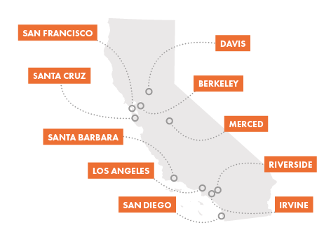
UC System IT Current State
Challenges:
Data gathering across UC difficult
No central hubs for info sharing
Opportunities:
~11,000 UC IT employees
Sharing resources & expertise between campuses
UCOP
& NATIONAL LAB
& ANR
Presented by Laura Prichard
Notes:
Script
References

Slide 3
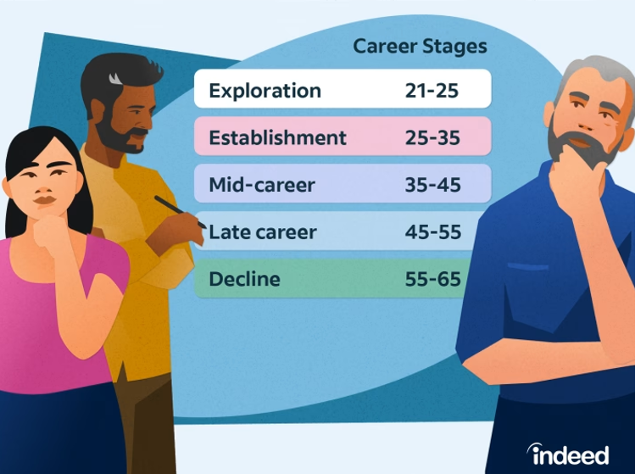
Career Stages
Stages as the 4 E’s (Source: ScreenSkills)
Entry Early Experienced Expert
Presented by Heather Grubb
Notes:
Thank you Laura.
Hi, everyone, I’m Heather Grubb from IT Services, UCLA.
I would like to share some research around Career Stages and how this relates to mentoring, coaching, and knowledge sharing.
Various resources define career stages in similar ways.
You can see Indeed and ScreenSkills definitions here on the screen, and also another resource Lumen Learning defines the phases as Growing, Exploring, Establishing, Maintaining, Reinventing.
The commonality is this notion that there is sort of an exploratory and growth into establishment and then reestablish, trying new things, and then eventually sort of hit your career peak if you will and then begin to transition out of a career.
What deeper research challenges us to keep in mind is that career stages are personal to us and we may not fit neatly into categories such as age ranges or educational level, and career phases are not necessarily experienced in a sequential order. Many factors come into play like socioeconomics, physical, and mental abilities, and unpredictable life events.
What is important about this is that mentoring and coaching is beneficial and inclusive of individuals in ALL career stages, AND knowledge sharing inevitability results as an integral part of the course of the mentor/mentee, coach/coachee relationship throughout a collaborative partnership. In other words, everyone learns, everyone benefits, regardless of career stage.
ALSO
Research shows there is a benefit of mentorship and coaching within and between the career stages. While traditionally we may think of a mentor as someone in a more established career mentoring someone in a growing stage, the reverse can also be true. Individuals growing and exploring can teach expert level colleagues in well rooted careers by helping them conquer their fears of reinventing themselves, or help remind those established and maintaining look at trying new things in their career.
Everyone can benefit from mentoring, coaching, and knowledge sharing through a give and take learning experience.
And now I am going to pass this along to Emily to talk more about mentorship.
References
1. https://www.indeed.com/career-advice/career-development/career-stages
2. https://courses.lumenlearning.com/waymaker-collegesuccess/chapter/text-stages-of-career-development/
3. https://www.screenskills.com/developing-your-career/continuing-professional-development/understanding-your-career-stage/
4. www.careersmart.org.uk
5. https:/www.bbc.com/worklife/article/20221110-reverse-mentorship-how-young-workers-are-teaching-bosses
6. The Handbook of Mentoring at Work: Theory, Research, and Practice by Bella Rose Ragins, Kathy E. Kram
7. Career Coaching for Different Life Stages by Gila Weinberg, CEO at Mikum Consulting 5/17/17, article on LinkedIn
Contact Information
Heather Grubb: hgrubb@it.ucla.edu

Slide 4
Mentorship
“A mentor is someone who allows you to see the hope inside yourself.”
– Oprah Winfrey
Presented by Emily Gladstone Cole
Notes:
Thank you, Heather. I’m Emily Gladstone Cole, with UC Berkeley.
I have mentored half a dozen groups of women who are trying to get into computer security, through a program run by the SANS Institute[1]. My mentees have achieved a lot, with a little bit of help, and helping them achieve their dreams has been an inspiration to me.
We have found some statistics that show the benefits of mentoring (they’re in our references), and people at UC agree, given the number of successful mentoring programs at individual UC sites like the one at U C O P that has been running since 2011, however those don’t help the employees whose most useful mentors may work at a different UC site.
There is a tremendous opportunity for us to build a unified mentoring program that can broaden employees’ horizons and increase their effectiveness, but it will take work to build a centralized way to administer and track mentoring relationships, publicize it to the UC community, and run a broader mentoring program.
We have put together a plan to run such a mentoring program, on the next slide.
References:
SANS Cyber Academies: https://www.sans.org/cyber-academy/
https://www.togetherplatform.com/blog/statistics-on-mentorship
https://chronus.com/blog/benefits-of-mentoring-programs
https://mentorloop.com/blog/mentoring-statistics/
https://link.ucop.edu/2011/04/12/ucop-mentorship-program-initiates-matchmaking-process/

Slide 5
Iterate, improve, and grow with a broader group
Get buy-in
from leadership
UC-Wide Mentorship Program
Leverage UC Tech, UCOP comms to publicize
Confirm local coordinators
at each site
Presented by Emily Gladstone Cole
Notes:
A more detailed version of the plan is on a slide at the end, but the highlights are:
First, get buy-in from leadership - that’s why you are here, and I hope you will help.
Next, identify local resources to coordinate the program at each site.
After that, leverage UC Tech and, in later rounds, U C O P comms channels to publicize and promote the program to a trial group.
Finally, iterate and improve and grow the program with participants across the UC system.
We think the benefits of such a program would be tremendous.
From Mentoring, let’s turn to Coaching. I’ll pass the baton to Marisa Strong.

Slide 6




Coaching
Proven effectiveness across employee groups
Onboarding ⬆82% retention rates
Skills Development ⬆36% leadership skills / ⬆32% employee engagement
Accelerated Adaptation ⬆60% faster
Leadership Effectiveness & Organizational Impact
Peer-to-Peer
Skills based
Upskill / reskill
in response to GenAI
Traditional
Goals based
If you don’t know where you’re going,
any road will take you there.
GenAI can amplify coaching programs
Presented by Marisa Strong
Notes:
Thanks Emily - Hello, I’m Marisa Strong from the California Digital Library at UC Office of the President,
Coaching is a proven model within organizations for improving performance, development and growth. And it can be applied to different roles of employees throughout their career.
There are many studies supporting the effectiveness of coaching - from the stage of a new hire with increased retention rates of 82% - to employees undergoing a role transition - adapting 60% faster to their new roles
Our MOR cohort group is becoming a proven model here at UC where employees across the system work with coaches to develop our leadership skills and become more effective leaders.
Coaching is typically facilitated through a location’s learning & development department or sought through an external provider. Some campuses such as UC Berkeley have extensive programs for both traditional and peer-to-peer programs
Peer to peer programs tend to focus on skill development whereas
Traditional coaching programs are primarily focused on providing support in achieving specific goals.
An example of how Peer-to-peer coaching can play a role - is in the response to Generative AI and its impact in the workplace - which will no doubt alter workflows and the skills necessary to get our work done.
As IT leaders, as we understand where and how Gen AI will impact skills to inform our training - we can facilitate the development of these skills through peer-to-peer coaching, building upon the strengths and potential of our existing employees.
GenAI itself can be leveraged to amplify coaching programs - to become personalized, data-driven, and scalable ultimately enhancing the effectiveness and the impact on employee development.
However, it's crucial to address potential challenges to ensure a balanced approach combining the strengths of both AI and human coaches.
To hear more of how our employees can support each other, I’ll pass off to James to talk about knowledge sharing
Resources:
UC Peer Connection Community | People & Culture
Generative AI and preparing for a shift to skills-based hiring | CIO
Enhace Your Coaching Impact with GenerativeAI

Slide 7















Knowledge Sharing
Knowledge sharing options
"Assists make two people happy, points just make one happy." - Nikola Jokic
Presented by James Cha
Notes:
Hi everyone, I’m James Cha from UC Merced and we want to encourage sharing knowledge across UCs so here are solutions that we found
First, Zoom webinars: online sessions on projects, insights, or best practices
Webinars can be recorded and shared for future use or for those who miss them.
second, A channel in the UC Tech slack: a place to post questions, share resources, or seek feedback.
third, a Wiki platform: for example at uc merced we use Confluence where we can create, edit, and share documents, pages, or blogs.
finally, a Central storage location Box, OneDrive, Google Drive: a place to store, access, and share files and documents and also reduces duplication of files

Slide 8
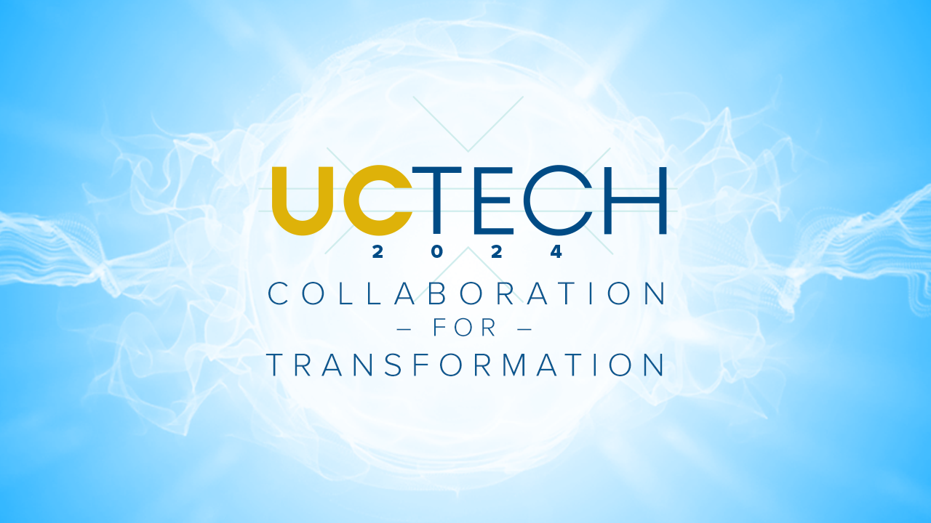

Recommendations
Thank you!
Build central website of resources
Leverage UCOP Mentoring Program
Encouragement through gamification
UC-wide leadership investment
Presented by James Cha
Notes:
So lets wrap it up with Whats next and our recommendations.
We want promote these ideas through events such as UC Tech and Educause where there are great opportunities to meet and collaborate with other uc employees
We also want to leverage employee resource groups to hopefully reach even further outside of just IT
Essentially want to encourage a community of practice
And also build a central web page to host resources for everyone in the UC to access information on mentoring, coaching, and knowledge sharing
Next, We want to build on the success of the UCOP Mentoring Program which has been successfully running for over a decade and start them on other UC campuses as well
On top of that we want to gamify the program to encourage participation with the use of leaderboards, recognition, and incentives
Ultimately, We found there are very few opportunities like these across the UCs and call on leadership for support to invest in mentoring, coaching, and knowledge sharing
We added our references and a sample mentorship program at the end that you all can check out. Thank you for listening

Slide 9
References
Mentorship:
Retention rates are 22% higher for Mentees, and 20% higher for Mentors.
Mentees are promoted 5x more often, and all participants are more likely to get a raise.
Mentors can and should learn from their mentees as well: 84% reported that mentoring relationships provide two-way inspiration for mentor and mentee.
Career Stages:
https://www.indeed.com/career-advice/career-development/career-stages
https://courses.lumenlearning.com/waymaker-collegesuccess/chapter/text-stages-of-career-development/
https://www.screenskills.com/developing-your-career/continuing-professional-development/understanding-your-career-stage/
www.careersmart.org.uk
https:/www.bbc.com/worklife/article/20221110-reverse-mentorship-how-young-workers-are-teaching-bosses
The Handbook of Mentoring at Work: Theory, Research, and Practice by Bella Rose Ragins, Kathy E. Kram
Career Coaching for Different Life Stages by Gila Weinberg, CEO at Mikum Consulting 5/17/17, article on LinkedIn
Knowledge Sharing:
Knowledge Sharing at Work
Promoting Knowledge Sharing
Knowledge sharing best practices
UC Tech Slack
UC Tech 2024 Conference
Additional Information:
UC Facts & Figures
IT payroll employee numbers from UCPath (via Laurel Skurko, UCOP)

Slide 10
Details: UC-Wide Mentorship Program
Work with executive sponsor to get buy-in and resources to manage a UC-wide mentorship program
Survey to UC IT, HR, L&D Leaders and members to identify existing mentorship programs, their successes, and resources involved
Define the goals, objectives, and guidelines for the program
Identify partners at each UC site
Build tooling to match mentors and mentees, track progress
Launch event at UC Tech to generate excitement and get initial participants
Match mentors and mentees and provide resources and guidance to all participants
Maintain excitement through gamification with leaderboards, badges, and employee recognition
Gather feedback to share with participants and adjust for next round
Market coaching and mentorship program through UC-wide communications

